Slide 1

Project Briefing
Elevator Controller System
2023/2024-1
FACULTY OF COMPUTING

Slide 2
Overview
The project is to implement knowledge from this course by simulating an imaginary case study.
The project is done in a group of 3 or 4 students
Strategies used:
  Group self explore
  Creative problem solution and design
  Good reporting and presentation

Slide 3

Case Study
To design an electronic controller for elevator / lift in a hotel building

Slide 4
Case Study
Scenario:
  A hotel visitor will use the elevator to go up / down from one level to another
  The visitor will key in the desired level to go, tag the visitor room card, close the elevator door and push UP / DOWN button
  Then the elevator will go UP / DOWN by counting UP / DOWN one level to another until it reaches to desired level

Slide 5
Scenario
Lift UP
Lift DOWN
Key in level up
Tag in card hotel
Door Close
Lift goes up to destination
Lift stop at destination
Door Open
Key in level down
Tag in card hotel
Door Close
Lift goes down to destination
Lift stop at destination
Door Open

Slide 6
Basic Design
4 floor elevator system
  For level 0, 1, 2, and 3
  Use 2-bit up/down counter
    0 = count UP
    1 = count DOWN
  Function in synchronous mode
  Uses D flip flop

Slide 7
Basic Design
Saturated
State diagram:
1
1
00
01
0
0
0
11
0
1
10
1

Slide 8
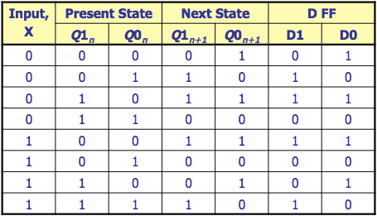
Basic Design
Next State and flip flop transition table:
1
1
1
1
0
0
0
0

Slide 9
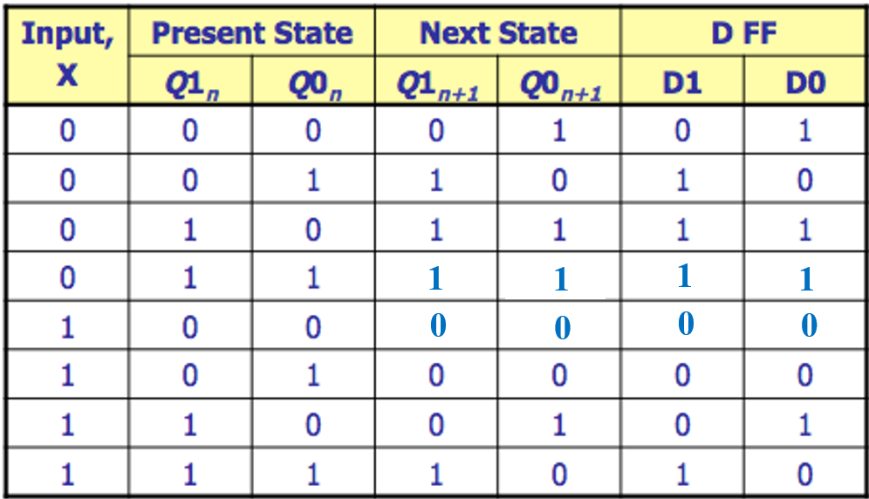




Basic Design
K-map:
Q₀
XQ₁
 | 0 | 1
00 | 0 | 1
01 | 1 | 1
11 | 0 | 1
10 | 0 | 0
$D_{1}=\overline{X}Q_{0}+\overline{X}Q_{1}$+ $Q_{1}Q_{0}$
$$D_{1}$$
Q₀
XQ₁
 | 0 | 1
00 | 1 | 0
01 | 1 | 1
11 | 1 | 0
10 | 0 | 0
$D_{0}=\overline{X}\overline{Q_{0}}+\overline{X}Q_{1}$+ $Q_{1}\overline{Q_{0}}$
$$D_{0}$$

Slide 10
Basic Design in DEEDS
Flip-flop using D Flip-flop
Comparator for current state and targeted level floor using XNOR and NAND
Pattern detector for clock enabler using AND gate.
  If output AND gate is HIGH, clock is enabled, and counter can run.
Use push button instead of clock generator.
  This is to eliminate undesirable state during states transition

Slide 11
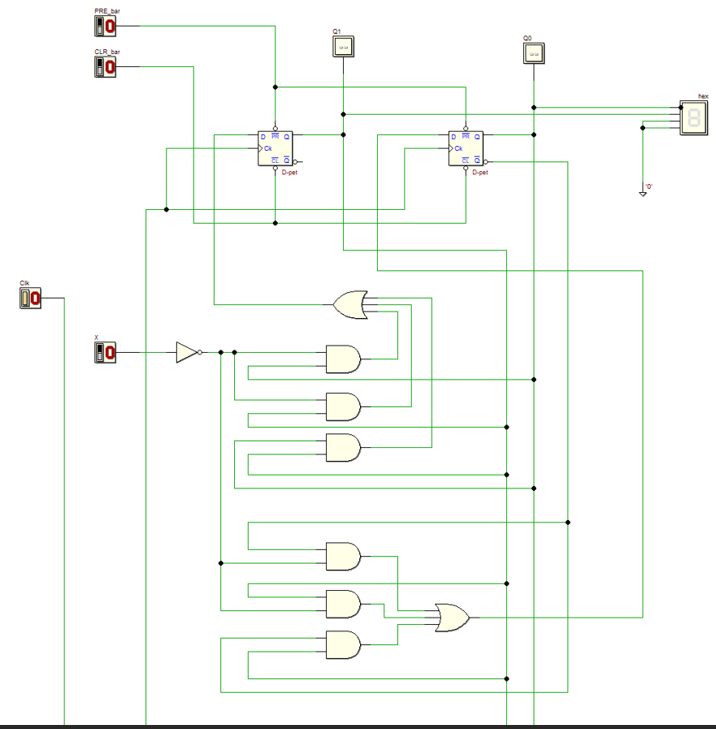
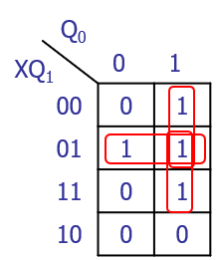
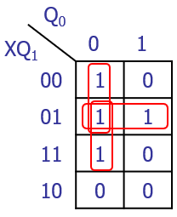


Design in DEEDS
2-bit UP/DOWN counter using D flip flops
$D_{1}=\overline{X}Q_{0}+\overline{X}Q_{1}$+ $Q_{1}Q_{0}$
$D_{0}=\overline{X}\overline{Q_{0}}+\overline{X}Q_{1}$+ $Q_{1}\overline{Q_{0}}$

Slide 12
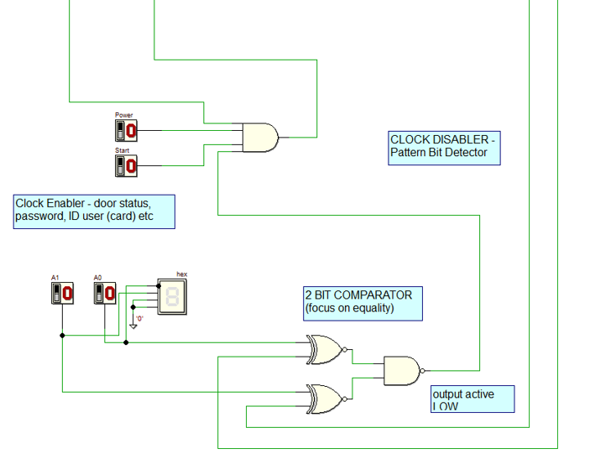
Design in DEEDS
Clock Enabler and Comparator
To clock input
Rule
Clock to the counter will enable when HIGH input goes to clock D flip-flop
Gate AND will goes HIGH when CLK (push button) is HIGH and Power is HIGH and Start is HIGH and output comparator IS NOT EQUAL.
If comparator is equal, then NAND gate will generate output LOW, Thus, will disable the clock to D flip-flop..

Slide 13
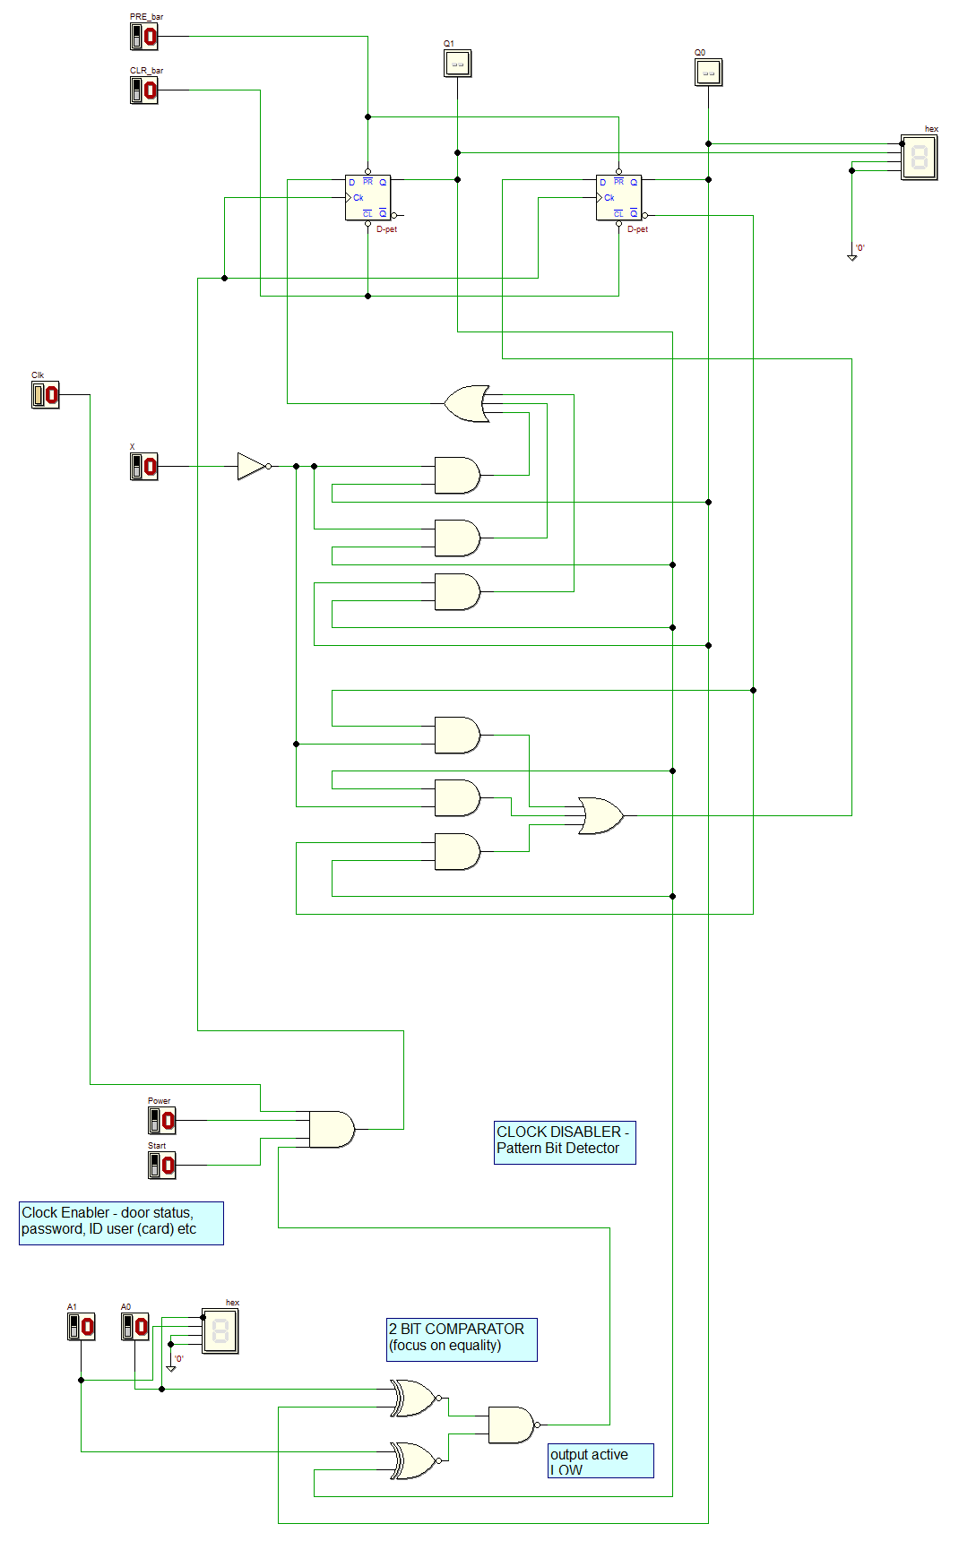
Operation:
Set value (UP)
PRE_bar=CLR_bar= 1
X=0 (count up)
Power=1
Give desired floor, e.g = 3 (from current
floor = 0)
Start=1
Push clock button ( Clk ), counter will do count up from initial (current 0) to desired floor 3.
Set value (Down)
PRE_bar=CLR_bar= 1
X=1 (count down)
Power=1
Give desired floor, e.g = 0 (from current floor =3)
Start=1
Push clock button ( Clk ), counter will do count down from initial (current 3) to desired floor 0.

Slide 14
Your job …
You must enhance the previous design to 3-bit synchronous counter ( count UP/DOWN ) to support 8 floors hotel elevator.
Thus, must show 4 inputs K-map, i.e., X, Q₂, Q₁, Q₀ to design the counter circuit and related states / flip flop transition tables.
Use JK flip flop in your circuit design.
Refer to Group Registration form for counter count direction.

Slide 15
Your job …
Introduce more features to the input controller such as
  to detect visitor card hotel
  to indicate door open / close
  to use passcode

Slide 16
Submission
Project report
Deeds source file ( *.pbs )
Demo video
DUE: 28 January 2024
Submit via elearning.utm.my

Slide 17
Report Format
Format
Times New Roman 12 font size
1.5 spacing
What should be in the report?
TITLE PAGE
DEDICATION & ACKNOWLEDGEMENT
TABLE OF CONTENTS
REPORT CONTENT
REFERENCES
APPENDICES
Under Appendices:
List of tasks distribution
among members of group
Photo(s) of your group working together
And others supporting materials that will strengthen the explanation of your project.

Slide 18
PROJECT REPORT CONTENT
Background / overview
Problem Statement
Suggested Solution
  must include all the diagrams / tables and explain
  … state diagram, state table, transition table
System Implementation (must include DEEDS drawing and explain)
Conclusion and Reflection
  Summarizes the whole project. Write your reflections.
  Describe your achievements, strength and weaknesses.
  Propose future work to improve your design

Slide 19
DEMO VIDEO
Prepare 15 minutes video to demo / demonstrate your project outcome
Explain how you run the circuit simulation
Produce the demo video in mp4 format
Upload the demo video to elearning

